Slide 1

Adidas Sales Performance Analysis
A comprehensive evaluation of sales performance across regions, products, retailers, and channels to drive strategic decision-making.

Slide 2

EXECUTIVE OVERVIEW
Strong Financial Performance
$900M
$332M
42%
2M
Total Sales
Total Profit
Operating Margin
Units Sold
Revenue generated across all channels and regions
Strong bottom-line performance
Excellent profitability indicator
Average price of $45 per unit
The overall performance reflects a profitable and well-balanced sales strategy with effective pricing and healthy demand.

Slide 3

Sales Trends Throughout the Year
Seasonal Patterns
Strategic Opportunity
Peak sales observed around mid-year and year-end periods, with lowest sales in early months followed by steady recovery.
Targeted promotions during low-performing months could smooth out seasonal fluctuations and maximize revenue.

Slide 4
REGIONAL ANALYSIS
Regional Performance Breakdown
West Region
Northeast
~30% of total sales
Solid contribution with consistent performance
Strongest performing region with highest market share
Southeast
Midwest
Strong regional presence and steady growth
Lower performance presents growth opportunity
Unit sales distribution aligns closely with revenue, indicating consistent pricing strategy across all regions.

Slide 5
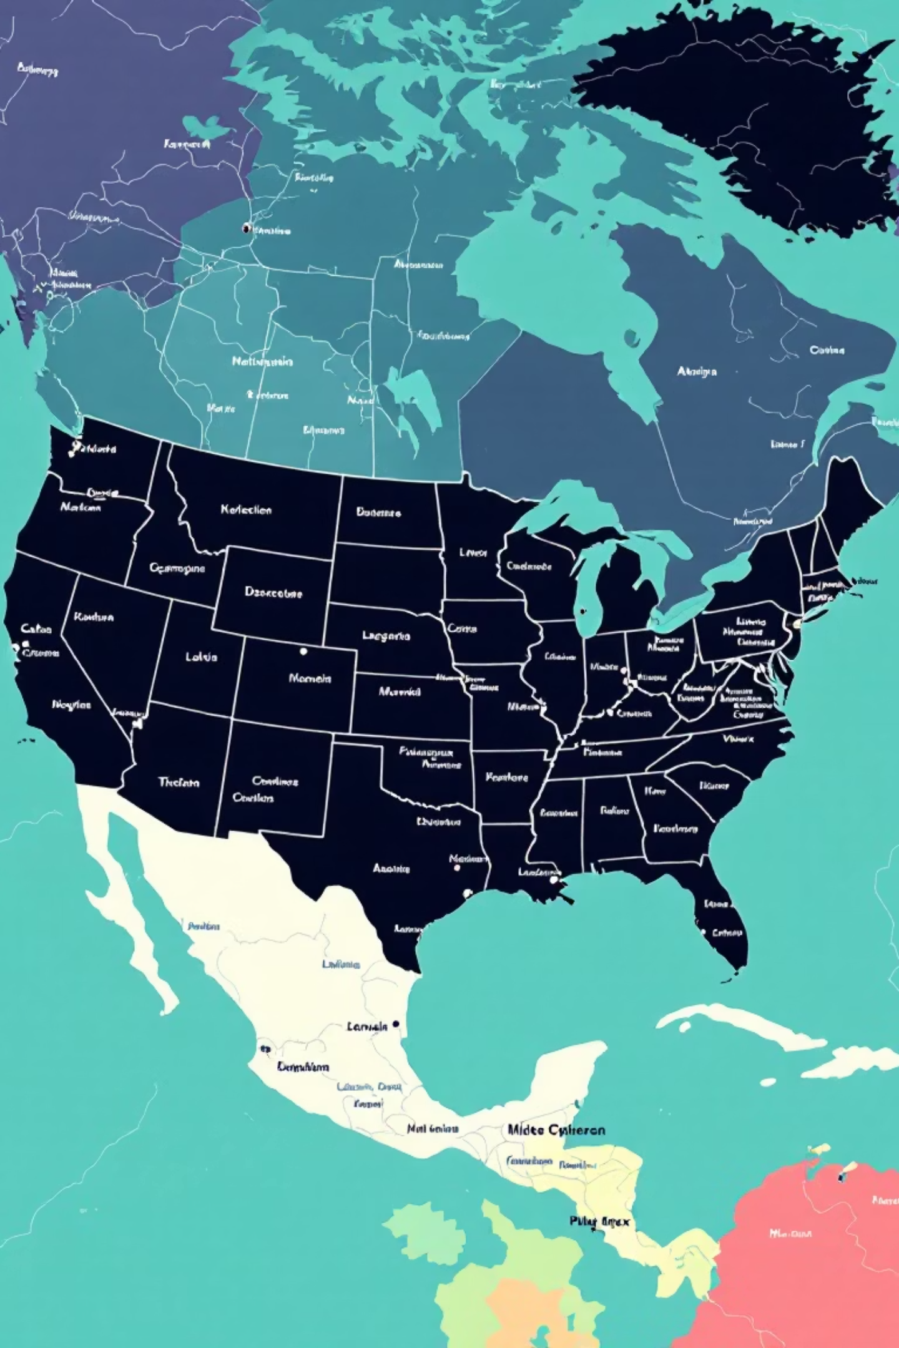
Top Performing States
1
2
New York
California
Leading state in total sales performance
Strong West Coast market presence
3
Florida
Top Southeast region contributor
Several states show moderate but consistent contributions, highlighting potential for targeted regional growth strategies.

Slide 6

PRODUCT INSIGHTS
Product Category Performance
Men's Street Footwear
Women's Apparel
Highest revenue-generating category
Strong performance and consistent demand
Diversified Portfolio
Lower-performing categories maintain steady sales, reducing single-product dependency

Slide 7




Retailer & Channel Distribution
West Gear
Foot Locker
Leading retail partner with highest sales volume
Strong partnership driving significant revenue
Online Channel
In-Store Sales
Growth opportunity in digital space
Dominant primary sales channel
In-store sales dominate, followed by outlet and online channels. Online sales present significant growth potential.

Slide 8

KEY INSIGHTS
Strategic Business Insights
Profitability Excellence
Regional Concentration
Strong margins indicate effective cost and pricing management across all operations.
Clear geographic strengths highlight where continued investment will yield highest returns.
Digital Opportunity
Online channel underperformance suggests significant scope for digital expansion and targeted marketing.

Slide 9
ACTION PLAN
Strategic Recommendations
Digital Expansion
Regional Marketing
Strengthen online sales strategies to capture digital-first customers and e-commerce growth.
Increase promotional activities in underperforming regions to balance sales distribution.
Seasonal Planning
Retailer Leverage
Optimize inventory and promotional planning using identified seasonal trends.
Use top-performing retailers and states as launch platforms for new products.

Slide 10


Driving Strategic Growth
This comprehensive analysis provides executive-level insights to support strategic planning, regional optimization, and channel growth initiatives for continued business success.
Next Steps: Implement recommendations across regional teams, strengthen digital presence, and leverage seasonal patterns for maximum impact.

